Slide 1


Slide 2


Slide 3
HHA HISTORY

Slide 4
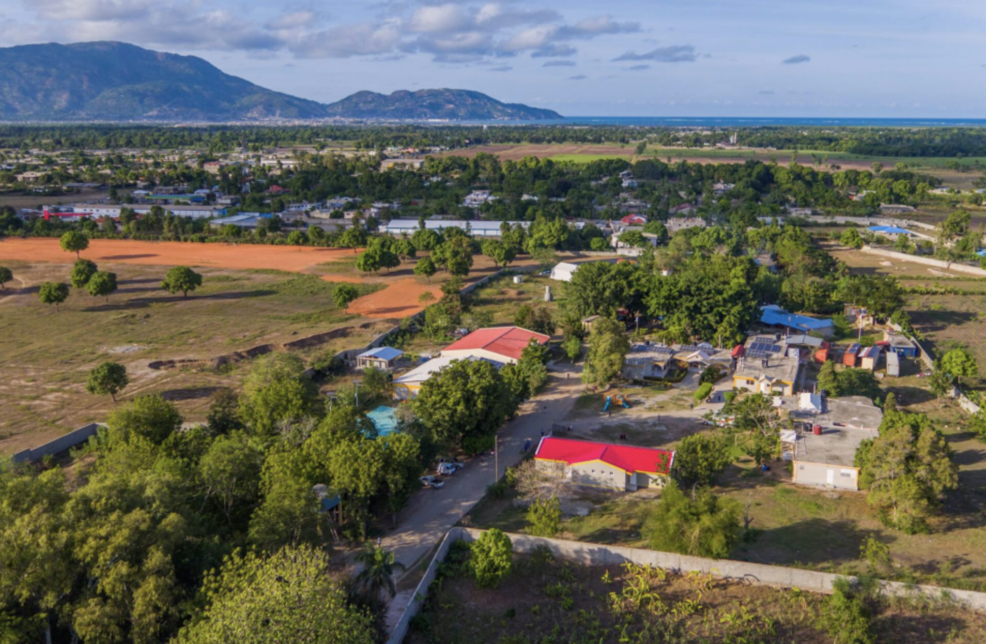

Slide 5
THE PROBLEM
Data is collected by hand, stored on paper
It’s easy to make mistakes with critical data
Little consistency across departments
Time delay before data gets back to HHA
Stories are difficult to collect, but have huge impact

Slide 6
HCBH APP HOMEPAGE
LEADERS BOARD Button or snapshot of a page to draw people in. The leader board would award departments on their interaction with the app
LEADERS BOARD
NICU/
PAED
MAT
REHAB
COM
HEALTH
These would be our first 4 departments that we’d like to focus on. Clicking on these would take us through to a home page for each
MESSAGE BOARD?
Case study of the month
MESSAGE BOARD Could be easy way for HHA UK/US or HCBH Senior Management to communicate with departments (translation poss?)
Easy to view previous month awarded best case study for all to see as encouragement…

Slide 7
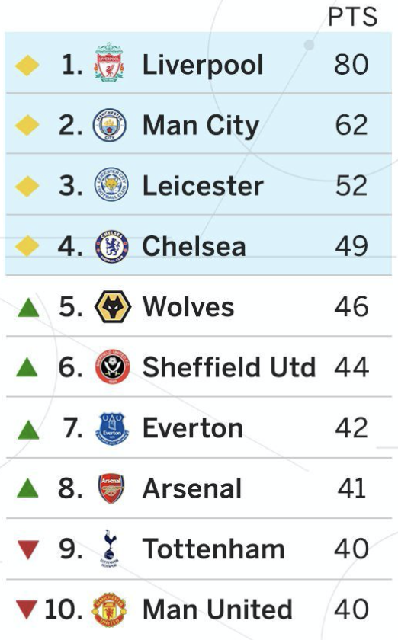
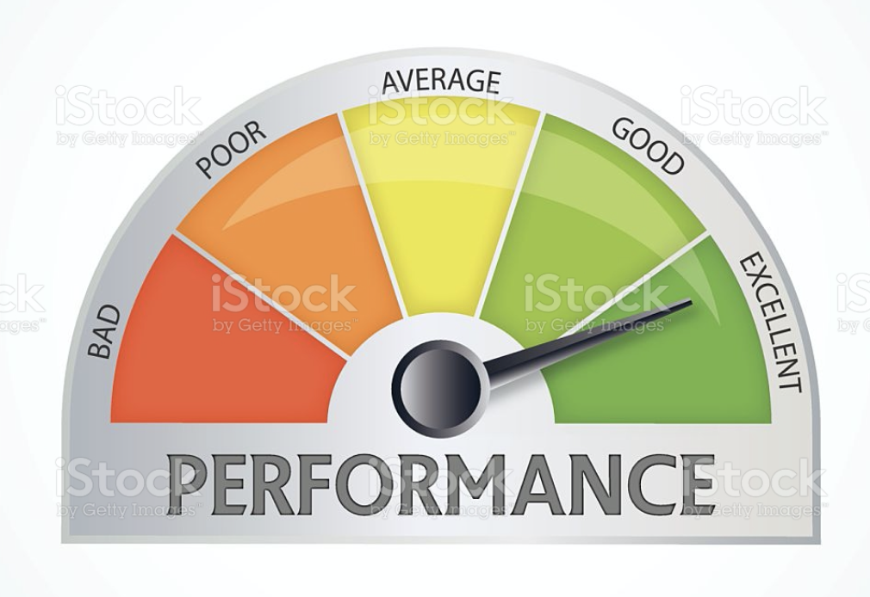

LEADERS BOARD
The leader board page would award departments on their interaction with the app, mostly likely based on (1) gaining points for submitting reports by agreed deadline and deductions to points if reports are late (2) number of case studies submitted (3) quality of case studies as voted by HHA. It would be nice if the best case study for that month could be shown for all to see with feedback from HHA UK as to why it won? However, it would be ideal for the app to automatically update the table based on some pre-set parameters
This page should be a bit of fun, easy to read – perhaps like a sports table but with a monthly announcement in nice graphic as to who won the department of the month and their prize (e.g. free meal at Mon Bijou, Drinks at Lakay), but with a score/table over 12 months so we can also give an annual award. We could also announce staff member of the month here.

Slide 8
NICU/
PAED
MAT
These would be our first 4 departments that we’d like to focus on. Clicking on these would take us through to a home page for each
REHAB
COM
HEALTH
Department Home Page
CASE STUDY (button) but ideally notifying user when next case study is due or a star for instance if done or warning if overdue
DATA (button) but ideally notifying user when next data submission is due or a star for instance if done or warning if overdue
EMPLOYEE OF MONTH (button) but ideally notifying user when next data submission is due or a star for instance if done or warning if overdue
BIOMECHANIC SUPPORT (if there’s time)
Could include their points tally just to encourage them….

Slide 9
These departments may get split into two unique departments
There are other departments that will require being added to the app later on. The app should enable the back end user to add new departments as needed.
DATA TYPES
REHAB
NICU/PAEDS
5? Other departments
The Ministry of Health requires us to gather this info 1 x per month from the relevant departments
Same MSPP data required
HHA additional separate data
In addition to Ministry of Health Data, there are additional data needs that HHA require.
This should be entered in monthly. Back-end date should be able to clearly show (ideally through automated charts/graphs) things like:
Per department data JUST MSPP (not inc. HHA secondary data)
Per department data including HHA data
All department data (total of all MSPP results across hospital. E.g. New admissions in Rehab = 1, New admissions in NICU = 3, Total Hospital New admissions = 4)
Cumulative annual data for the above (ideally where back end user can choose date of start and end point of cumulative date. E.g. March 2021-Sept2021)

Slide 10
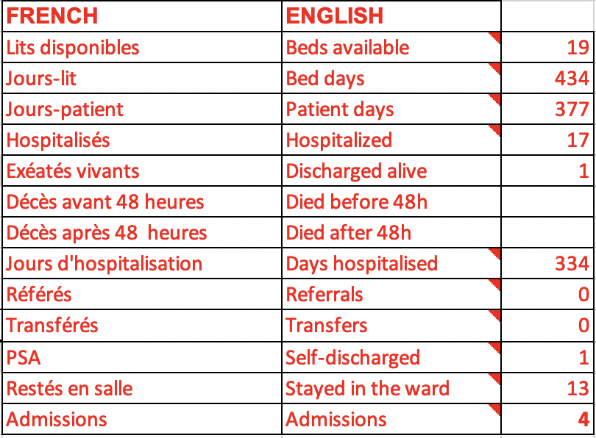
REHAB
NICU/PAEDS
5? Other departments
Same MSPP data required
The Ministry of Health requires us to gather this info 1 x per month from the relevant departments

Slide 11

ADDITIONAL DATA

Slide 12
Other Points to Consider
files/results to be downloadable (printable)
additional departments or data fields to be added as needed by end user without expensive ongoing consultant fees
need data to have cumulative capacity. E.g can view months separately or a total of them together
back-end results should offer clear graphs/tables which can in time be used to review trends etc. and offer snapshot info for busy heads of departments
needs to be easy to use, but also ensuring a field isn’t missed. E.g can’t complete form until all points are filled - ideally stating which question is answered wrong
is dual language possible trough out or just back end? E.g. French, Creole, English

Slide 13
CASE STUDY Home Page
PREVIOUS CASE STUDIES A button that takes you through to log of previous case studies
NEW CASE STUDY (button) but ideally notifying user when next case study is due or a star for instance if done or alert when overdue
Should include things like (1) has permission been sought from patient/staff member for this story (2) automated fields with word limit with specific questions. E.g. tell us about this patient story… (3) way to easily upload photos – perhaps with example of a good photo (4) easy to download info for social media use etc. (5) translate function so staff can input in Creole or French but UK team can read in English? This doesn’t have to be a patient story. Could be some training that happened, a patient coming back to say thanks, new equipment.

Slide 14
EXTRA IDEAS

Slide 15
Department Home Page
EMPLOYEE OF MONTH (button) but ideally notifying user when next data submission is due or a star for instance if done or warning if overdue
Historical awards or recommendations?
Similar to case study, easy way (with fields and photo capture) for Heads of Department to vote for HCBH Employee of the Month (questions like, Who, Why etc…)

Slide 16
BIOMECHANIC Page
HISTORICAL LOG: This can show what equipment has been reported to Biomed team and outcome of referral. E.g. the biomeds can state if (1) issue is resolved, unit returned to department, (2) fix pending – with estimated completion date, (3) Temp. Out of commission – long term issue pending foreign team, (4) broken, not fixable
BIOMECHANIC SUPPORT (if there’s time). All Biomed fixes should be entered through this page…
REPORT BROKEN KIT: Easy way for Heads of Dept to notify biomed team of broken equipment with custom fields like,
EQUIPMENT (with photo?)
Fault:
Date:
Priority:
Urgent (lifesaving equipment that needs emergency attention
Important (important but not life/death)
Non-urgent (we can survive without)
BIOMED PAGE:
This would alert Biomed team through message alerts and put into an automated inventory (based on urgency) but also notify them of kit they may not have responded to (e.g. after 2 days for urgent, 5 days important, 2 weeks non-urgent) as example. This page would be viewable by HCBH Heads and HHA. Inc. function for Biomeds to request HHA support through a support form.
Support form:
Who is support needed from? HCBH (money to fix) or HHA (foreign part). This could include on-line list of parts requiring support from abroad so we can keep tabs?

Slide 17

THANK YOU!
Any questions?
HOPEHEALTHACTION.ORG

